Slide 1
Deployment and Analysis

Slide 2
Agenda
DEPLOY
INVESTIGATE
PREP

Slide 3
Deployment

Slide 4
INVESTIGATE

Slide 5
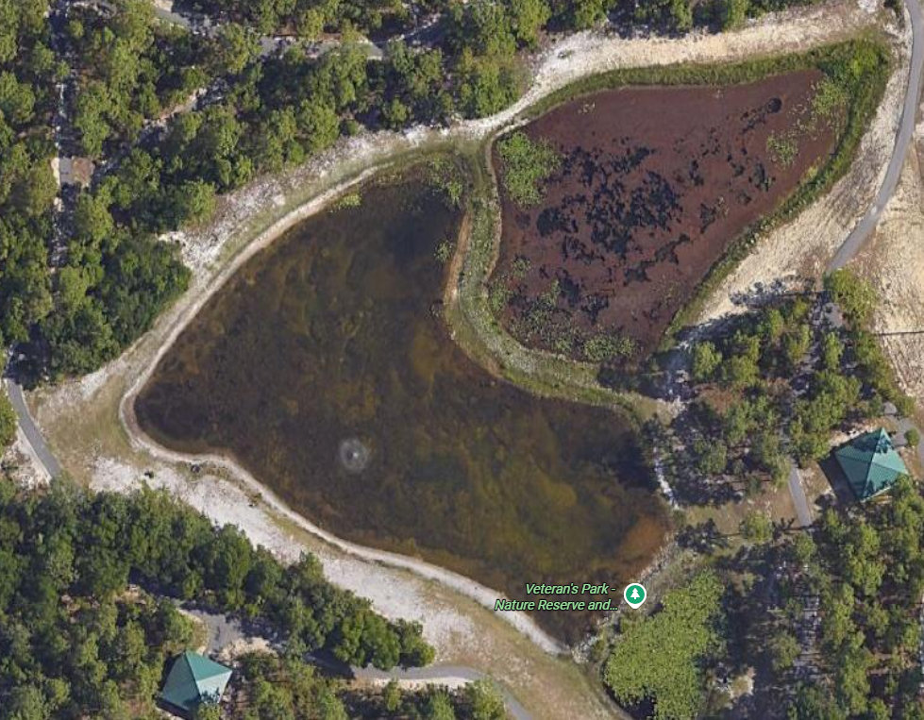
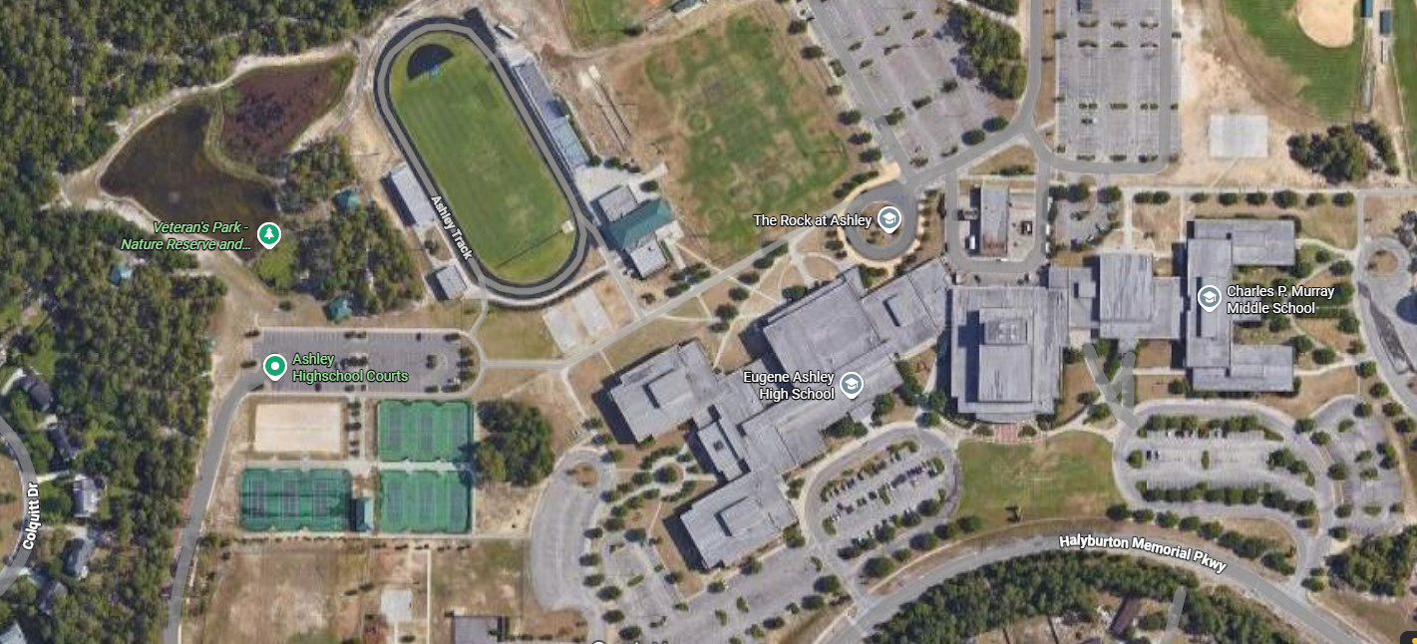
Where is this?

Slide 6
Stormwater Analysis
4
4
5
5
5 Groups
1 Measurement per a group
1 total Volume
1
2
3

Slide 7
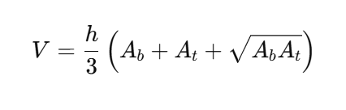
Assumptions Calculations
The retention pond is made up of upside down trapezoids
The depth is 4 feet the two main pools
The depth of the forebay is 3 feet
The slopes are 3H:1V
h = depth
A_{b} = Area of bottom
A_{t} = Area of the top
What will our volume units be?
1 cubic foot = 7.48 gallons of water
Notes:
May need to draw trapezoid

Slide 8
Each group needs:
Notebook + Pencil
Calculator
Tape Measure
Complete gallon calculation
And answer this question: Based on the 1st lesson what will impact how much water goes into the pond?
Notes:
Hand out print-outs with calculations and question

Slide 9
Preparation

Slide 10
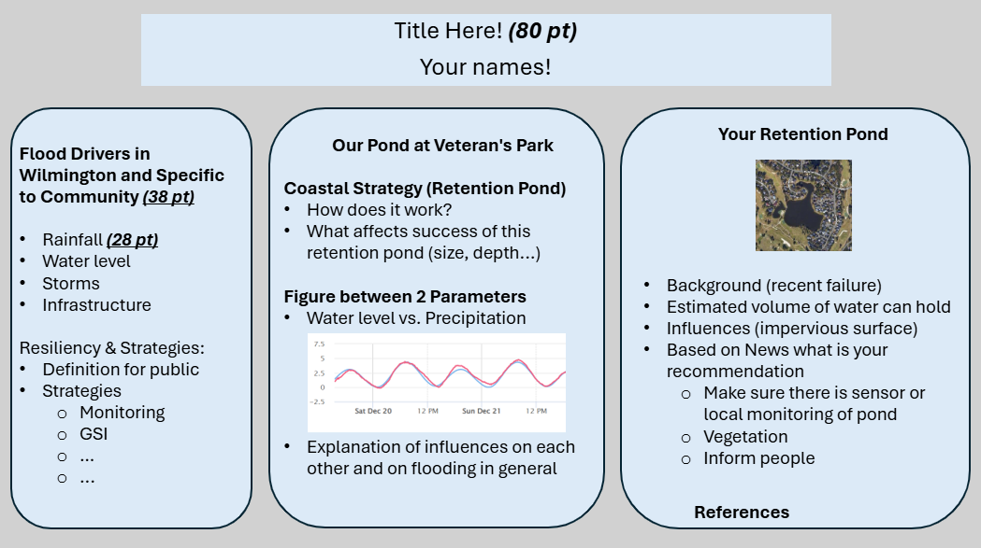
Poster Guidelines
4 ft
3 ft
Notes:
Guidelines and expectations. Give example.

Slide 11
Specific Retention Pond Options
Canterwood Pond
River Road Retention Pond
Carolina Beach Lake Park
Carriage Hills Pond
Notes:
Guidelines and expectations. Give example.

Slide 12
Next time…
Work on Poster!
Due by March 16th!
Notes:
Guidelines and expectations. Give example.

